Slide 1

Food Ordering Web Application
18CSP83
Review - 2
Date : 24/07/22
1CR20CS078 HARSHIL
1CR20CS206 TRIGUNESH RAI
Under the guidance of:
Prof. Shyamashree Gosh
Assistant Professor
Department of Computer Science & Engineering
Notes:
1

Slide 2
Food Ordering Web Application
TITLE

Slide 3
Developing a food ordering website using HTML, CSS & JAVASCRIPT
PROBLEM STATEMENT

Slide 4
DETAILED REQUIREMENTS
HTML
HTML stands for Hyper Text Markup Language.
IT is the code that is used to structure a web page and its content.

Slide 5
CSS
Cascading Style Sheets is a style sheet language used for describing the presentation of a document written in a markup language such as HTML or XML.
CSS is a cornerstone technology of the World Wide Web, alongside HTML and JavaScript.

Slide 6
JAVASCRIPT
JavaScript is a dynamic computer programming language.
Its implementations allow client-side script to interact with the user and make dynamic pages.

Slide 7
SOFTWARE TOOLS USED
VS CODE(v1.68)
HTML5
CSS3
JAVASCRIPT
W3School for some information

Slide 8
PROPOSED SOLUTION
First, we need to build a home page for the website.
In that homepage, there will a navigation bar, some details about website and some categories of groceries.
After that we are supposed to build separate webpages for each of the categories.
Then we will link each product selected by the user to the cart page.
At last, We will show a page displaying that customer has successfully placed the order.

Slide 9
TOTAL MAN HOUR & WORKS
15th JUNE - 3rd JULY : 4 hours (till review 1)
Started making front page Layout.
4th JULY – 2ND AUGUST : 7 hours (till review 2)
Making the website interactive.
Completed front page Layout.

Slide 10
OUTPUT
Website Design and Layout

Slide 11
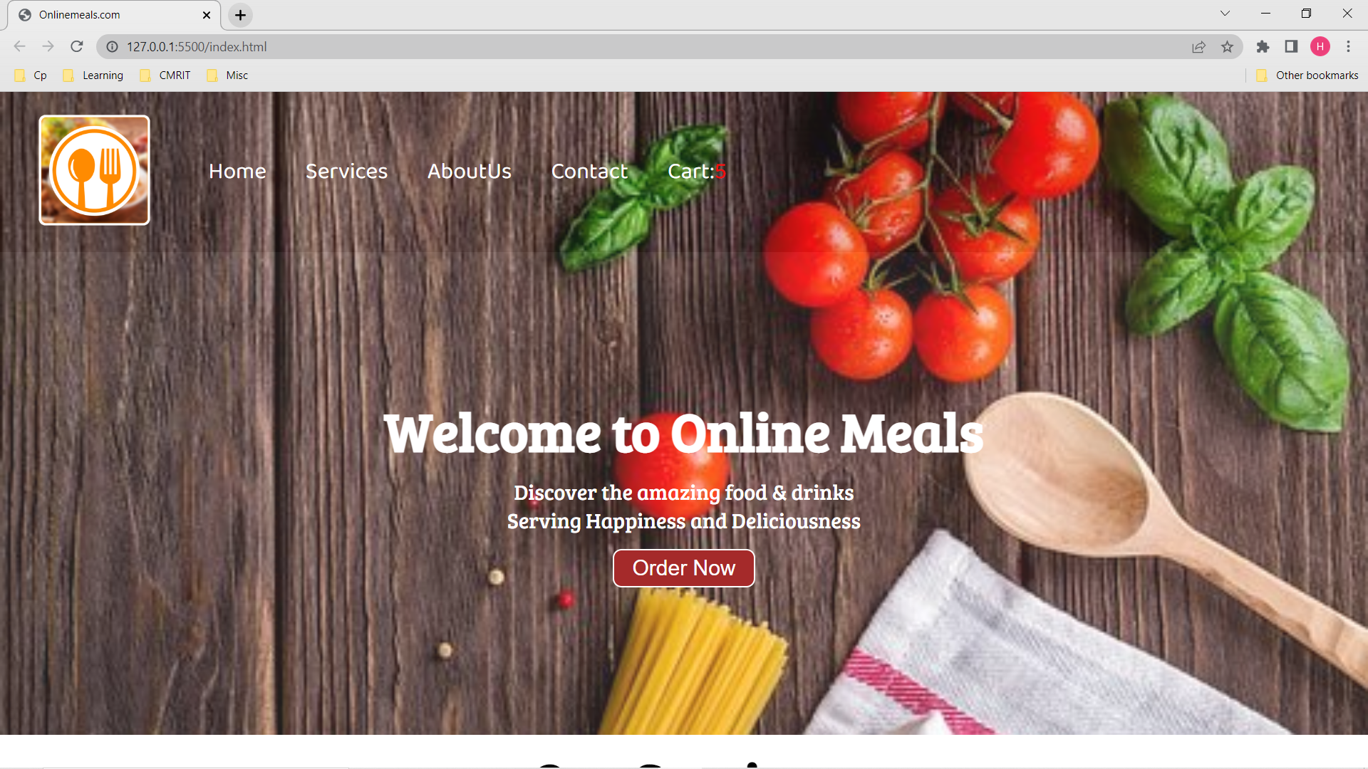

Slide 12
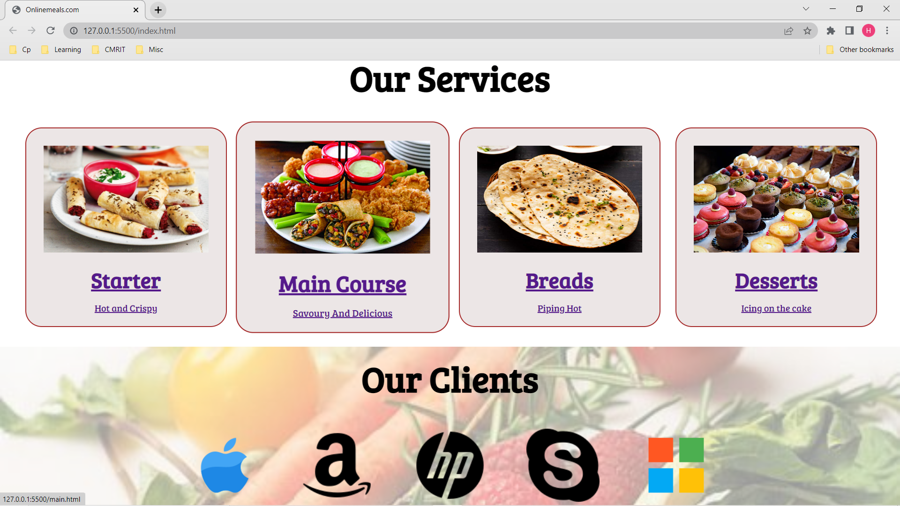

Slide 13
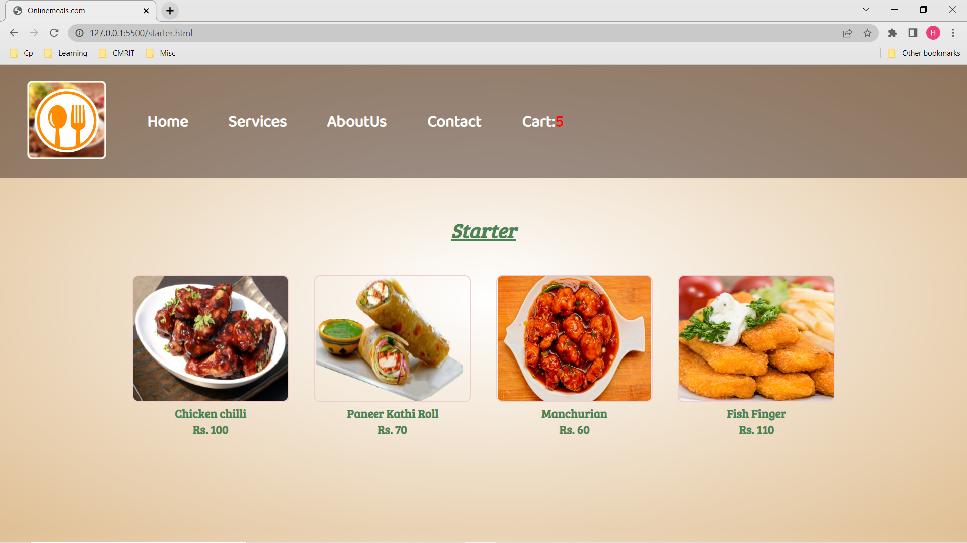

Slide 14
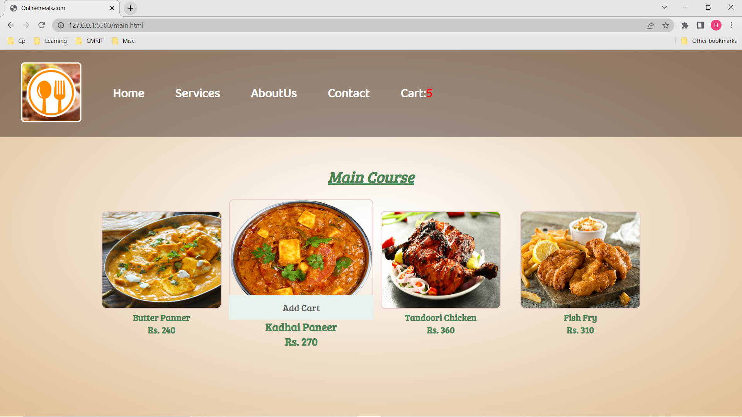

Slide 15
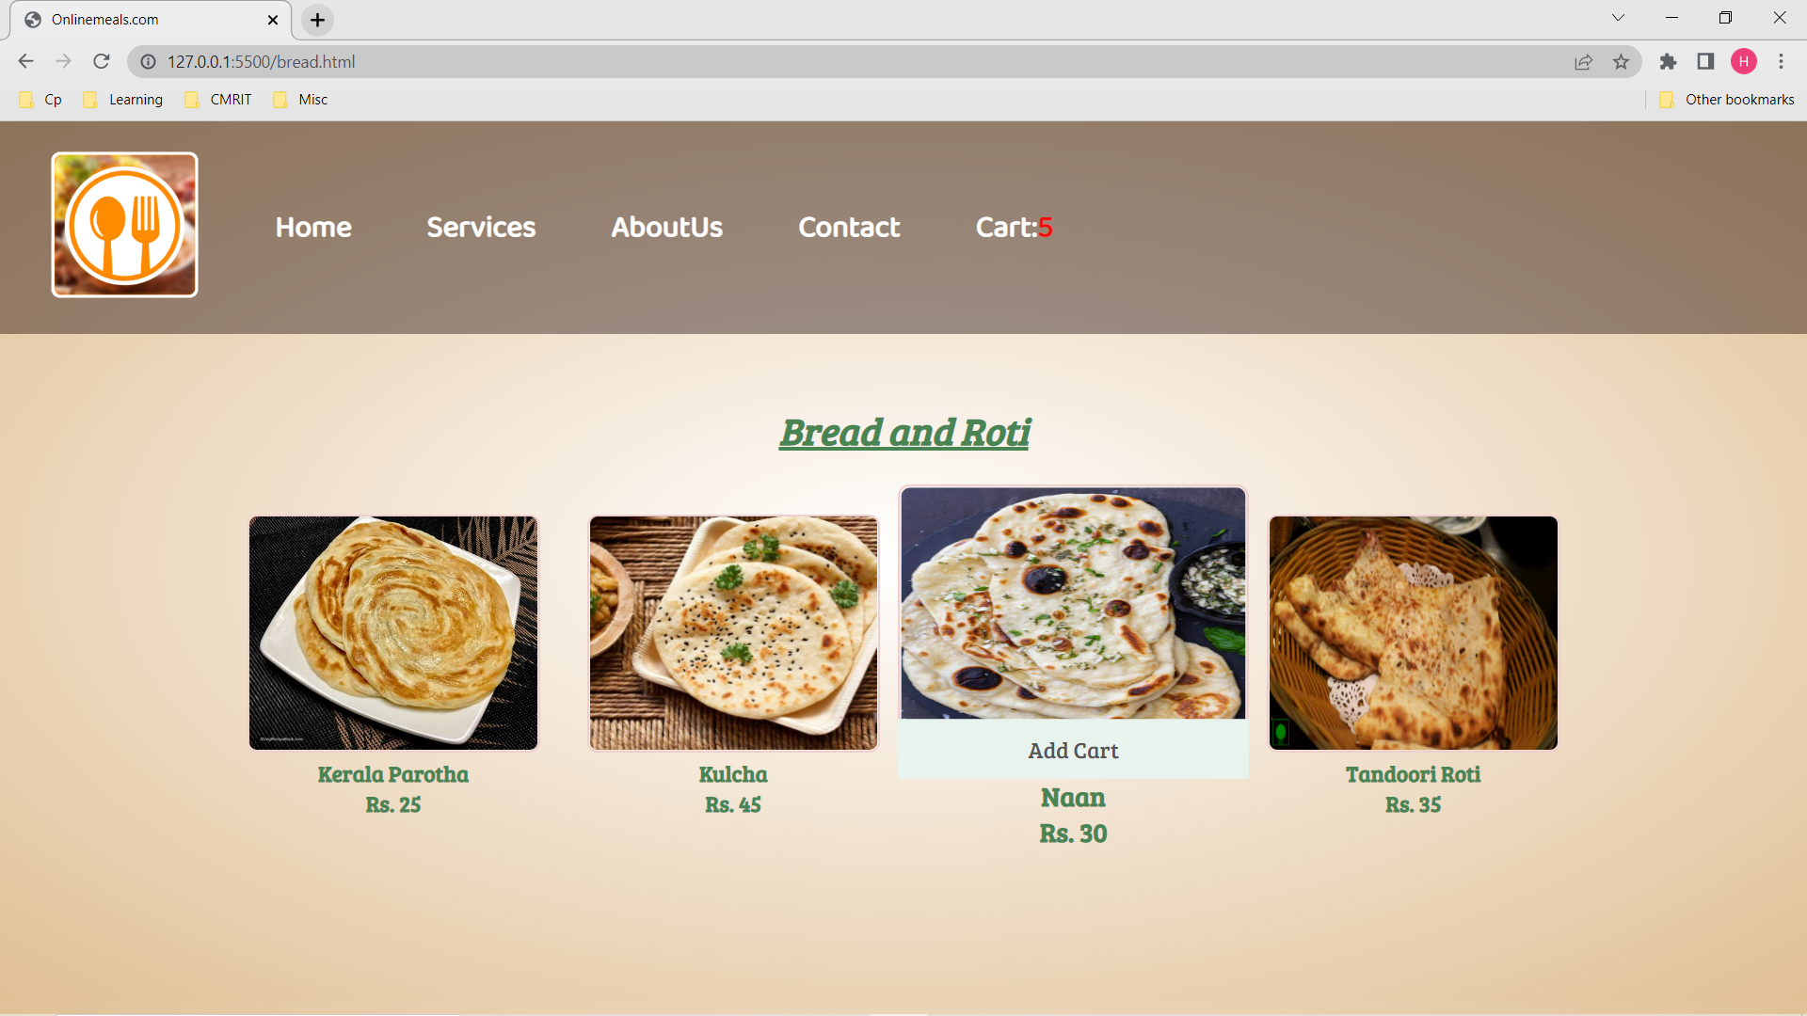

Slide 16
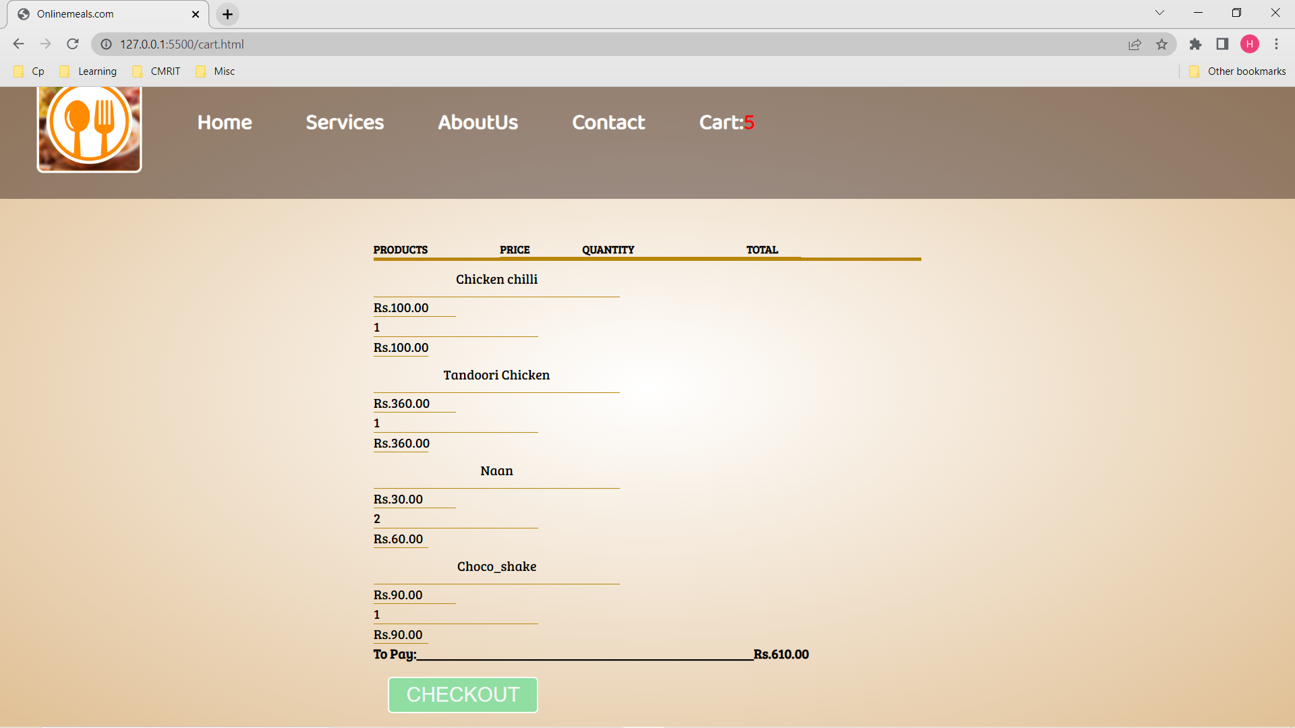

Slide 17
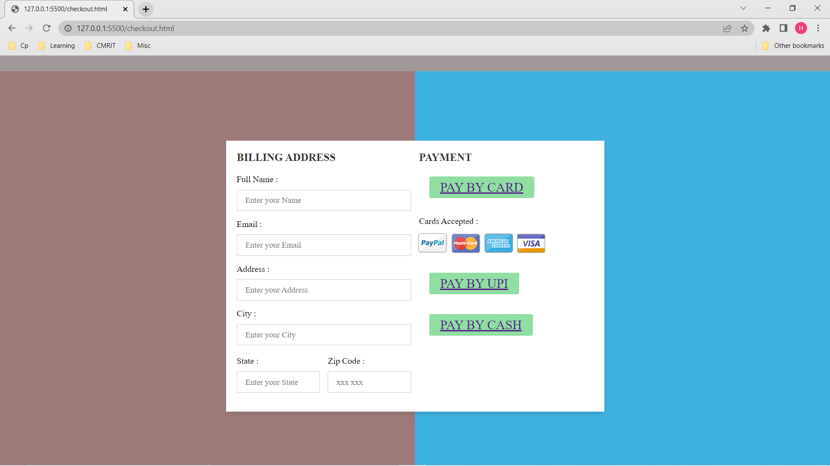

Slide 18
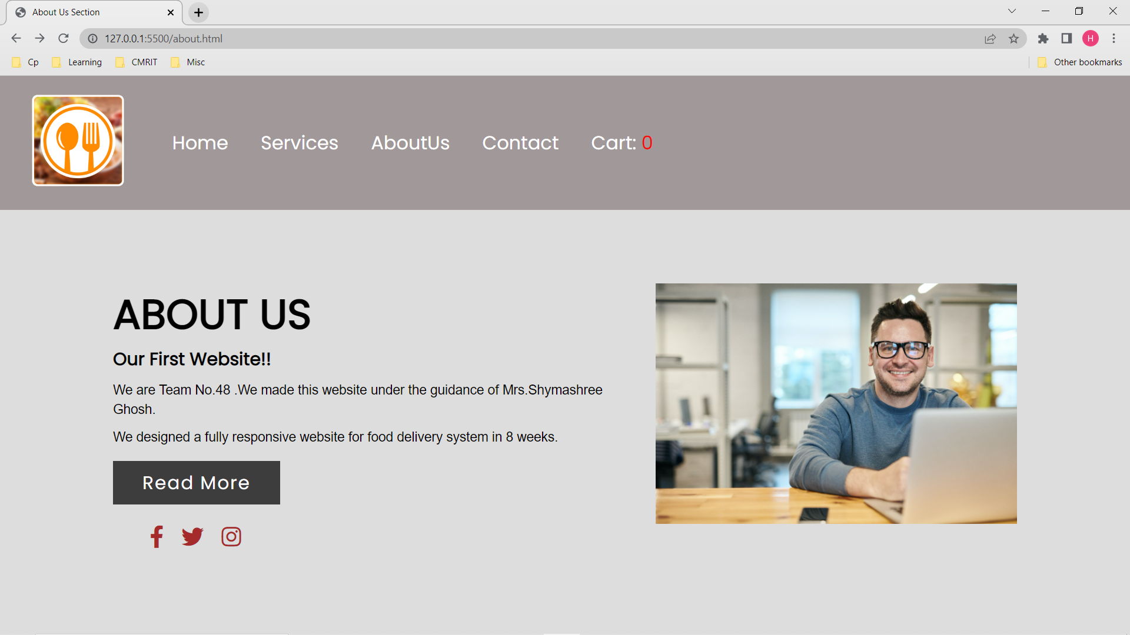

Slide 19
Thank you

